Slide 1
CMSC201 Computer Science I for Majors Lecture 20 – Binary (and File I/O)

Slide 2
Last Class We Covered
File I/O
How to open a file
For reading or writing
How to read from a file
How to write to a file
How to close a file

Slide 3
Any Questions from Last Time?

Slide 4
Today’s Objectives
To understand how data is represented and stored in memory
Binary numbers
Converting
Binary to Decimal
Decimal to Binary
To review what we learned about file I/O

Slide 5
“Bridge Course”
We are offering CMSC 291 again this summer
Course for CMSC/CMPE students who earn a “C” instead of the “B” required for their major
Grade must be result of a single poor score (e.g., did badly on the midterm or a project)
Won’t change CMSC 201 grade, but will allow eligible students to take CMSC 202 in Fall 18
An announcement was made on Blackboard containing all of the details last week

Slide 6
Binary Numbers

Slide 7
Binary Numbers
Computers store all information (code, text, images, sound,) as a binary representation
“Binary” means only two parts: 0 and 1
Specific formats for each file help the computer know what type of item/object it is
But why use binary?

Slide 8
Decimal vs Binary
Why do we use decimal numbers?
Ones, tens, hundreds, thousands, etc.
But computers don’t have fingers…
What do they have instead?
They only have two states: “on” and “off”

Slide 9
Decimal Example
How do we represent a number like 50,932?
2 x 10⁰ = 2
3 x 10¹ = 30
9 x 10² = 900
0 x 10³ = 0000
5 x 10⁴ = 50000
------
Total: 50932
ten thousands
thousands
hundreds
tens
ones
5
0
9
3
2
10⁴
10³
10²
10¹
10⁰
Decimal uses 10 digits, so…

Slide 10
Another Decimal Example
6 | 7 | 4 | 9 | 3
10⁴ | 10³ | 10² | 10¹ | 10⁰
10000 | 1000 | 100 | 10 | 1
60000 | 7000 | 400 | 90 | 3
60000+7000+400+90+3 = 67493

Slide 11
Binary Example
Let’s do the same with 10110 in binary
0 x 2⁰ = 0
1 x 2¹ = 2
1 x 2² = 4
0 x 2³ = 0
1 x 2⁴ = 16
--
Total: 22
sixteens
eights
fours
twos
ones
1
0
1
1
0
2⁴
2³
2²
2¹
2⁰
Binary uses 2 digits, so our base isn’t 10, but…

Slide 12
Binary to Decimal Conversion
Step 1: Draw Conversion Box
Step 2: Enter Binary Number
Step 3: Multiply
Step 4: Add
2⁹ | 2⁸ | 2⁷ | 2⁶ | 2⁵ | 2⁴ | 2³ | 2² | 2¹ | 2⁰
512 | 256 | 128 | 64 | 32 | 16 | 8 | 4 | 2 | 1
1 | 0 | 1 | 0 | 0 | 0 | 1 | 1 | 0 | 1
512 | 0 | 128 | 0 | 0 | 0 | 8 | 4 | 0 | 1
128 + 0 + 0 + 0 + 8 + 4 + 0 + 1 = 141

Slide 13
Exercise: Converting From Binary
What are the decimals equivalents of…
101
1111
100000
101010
0010 1010
1000 0000
Longer binary numbers are often broken into blocks of four digits for the sake of readability

Slide 14
Exercise: Converting From Binary
What are the decimals equivalents of…
101 = 4+0+1 = 5
1111 = 8+4+2+1 = 15
100000 = 32+0+0+0+0+0 = 32
101010 = 32+0+8+0+2+0 = 42
0010 1010 = 32+0+8+0+2+0 = 42
1000 0000 = 128+...+0+0 = 128

Slide 15
Decimal to Binary Conversion
Step 1: Draw Conversion Box
Step 2: Compare decimal to highest binary value
Step 3: If binary value is smaller, put a 1 there and
subtract the value from the decimal number
Step 4: Repeat until 0
Convert 163 to binary
2⁹ | 2⁸ | 2⁷ | 2⁶ | 2⁵ | 2⁴ | 2³ | 2² | 2¹ | 2⁰
512 | 256 | 128 | 64 | 32 | 16 | 8 | 4 | 2 | 1
1 | 0
1 | 0 | 0 | 0
1
1
163-128 = 35
35-32 = 3
3-2=1
1-1=0

Slide 16
Converting to Binary
What are the binary equivalents of…
9
27
68
216
255

Slide 17
Converting to Binary
What are the binary equivalents of…
9 = 1001 (or 8+1)
27 = 0001 1011 (or 16+8+2+1)
68 = 0100 0100 (or 64+4)
216 = 1101 1000 (or 128+64+16+8)
255 = 1111 1111 (or 128+64+32+16+8+4+2+1)

Slide 18
Binary Tips and Tricks
Some “sanity checking” rules for conversions:
Binary can only be 1 or 0
If you get “2” of something, it’s wrong
Odd numbers must have a 1 in the ones column
Why? (And what’s the rule for even numbers?)
Each column’s value is the sum of all of the previous columns (to the right) plus one
In decimal, what column comes after 999?

Slide 19
File Input and Output (Review)

Slide 20
Quick Review
Write the lines of code for the tasks below
Open the file “goodDogs.txt”
Read the file in (however you want), and print out each dog’s name in the sentence “X is a good dog”
Finish using the file (what do you need to do?)
goodDogs.txt
Thor,Corgi
Coco,Chocolate Lab
Beethoven,St. Bernard

Slide 21
Exercise: Jabberwocky
Write a program that goes through a file and reports the longest line in the file
Example Input File:
carroll.txt
Beware the Jabberwock, my son,
the jaws that bite, the claws that catch,
Beware the JubJub bird and shun
the frumious bandersnatch.
Example Output:
>>> longest.py
longest line = 42 characters
the jaws that bite, the claws that catch,

Slide 22
Jabberwocky Solution Pseudocode
inside main:
open the file "carroll.txt" (for reading)
create a variable to store the "longest" line
# we'll refer to this variable as "record"
# what should this variable be initialized to?
for each line of the input
if the current line is longer than the record
update the record to the current line
print the length of the longest line
print the longest line
call main

Slide 23
Jabberwocky Solution Code
def main():
inputFile = open("carroll.txt")
longest = ""
lines = inputFile.readlines()
for i in range(len(lines)):
if len(lines[i]) > len(longest):
longest = lines[i]
print("Longest line =", len(longest))
print(longest)
main()

Slide 24
Jabberwocky Solution Walkthrough
line =
Beware the Jabberwock, my son,
the jaws that bite, the claws that catch,
Beware the JubJub bird and shun
the frumious bandersnatch.
line = "Beware the Jabberwock, my son,"
longest = ""
longest = "Beware the Jabberwock, my son,"
len(line) > len(longest)
for i in range(len(lines)):
if len(lines[i]) > len(longest)
longest = lines[i]
31 > 0
✓

Slide 25
Jabberwocky Solution Walkthrough
Beware the Jabberwock, my son,
the jaws that bite, the claws that catch,
Beware the JubJub bird and shun
the frumious bandersnatch.
line =
line = "the jaws that bite, the claws that catch,"
longest = ""
longest = "Beware the Jabberwock, my son,"
longest = "the jaws that bite, the claws that catch,"
len(line) > len(longest)
for i in range(len(lines)):
if len(lines[i]) > len(longest)
longest = lines[i]
42 > 31
✓

Slide 26
Jabberwocky Solution Walkthrough
Beware the Jabberwock, my son,
the jaws that bite, the claws that catch,
Beware the JubJub bird and shun
the frumious bandersnatch.
line =
line = "Beware the JubJub bird and shun"
longest = ""
longest = "Beware the Jabberwock, my son,"
longest = "the jaws that bite, the claws that catch,"
len(line) > len(longest)
for i in range(len(lines)):
if len(lines[i]) > len(longest)
longest = lines[i]
32 > 42
✗

Slide 27
Jabberwocky Solution Walkthrough
Beware the Jabberwock, my son,
the jaws that bite, the claws that catch,
Beware the JubJub bird and shun
the frumious bandersnatch.
line =
line = "the frumious bandersnatch."
longest = ""
longest = "Beware the Jabberwock, my son,"
longest = "the jaws that bite, the claws that catch,"
len(line) > len(longest)
for i in range(len(lines)):
if len(lines[i]) > len(longest)
longest = lines[i]
27 > 42
✗

Slide 28
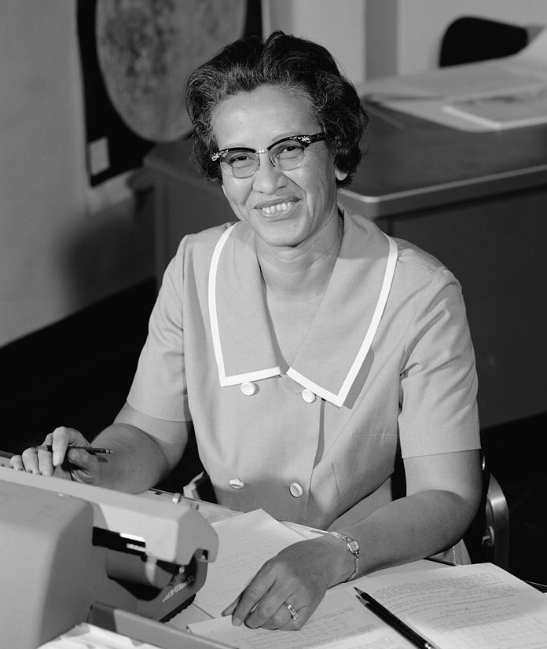
Daily CS History
Katherine Johnson
Worked as a NASA “computer”
Calculated trajectories, launch windows, and return paths for flights in Project Mercury
Plotted Alan Shepard’s 1961 journey to space (first American)
Also examined black box data from crashed air planes
Graduated college at age 18

Slide 29
Announcements
Homework 6 is available on Blackboard
Parts 4 and 5 do not require recursion
Homework is due on Friday, April 27th
Final exam is when?
Friday, May 18th from 6 to 8 PM
If you can’t take the exam then, you need to let Dr. Gibson know via email by Wednesday @ 9 PM

Slide 30
Image Sources
Katherine Johnson:
https://commons.wikimedia.org/wiki/File:Katherine_Johnson_at_NASA,_in_1966.jpg

